Slide 1
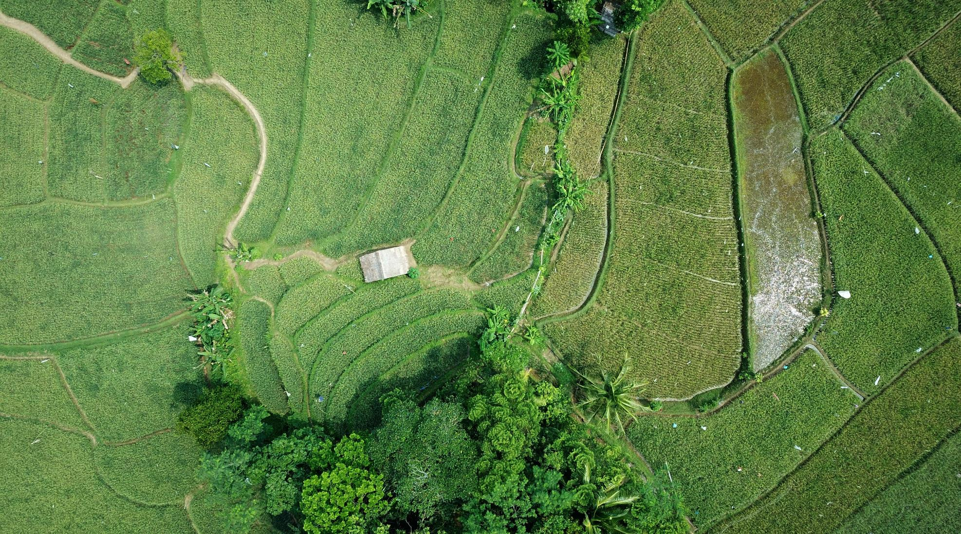
Vertical Farm: the best location in the city of Rome Massimo Cireddu – 28/03/2021

Slide 2
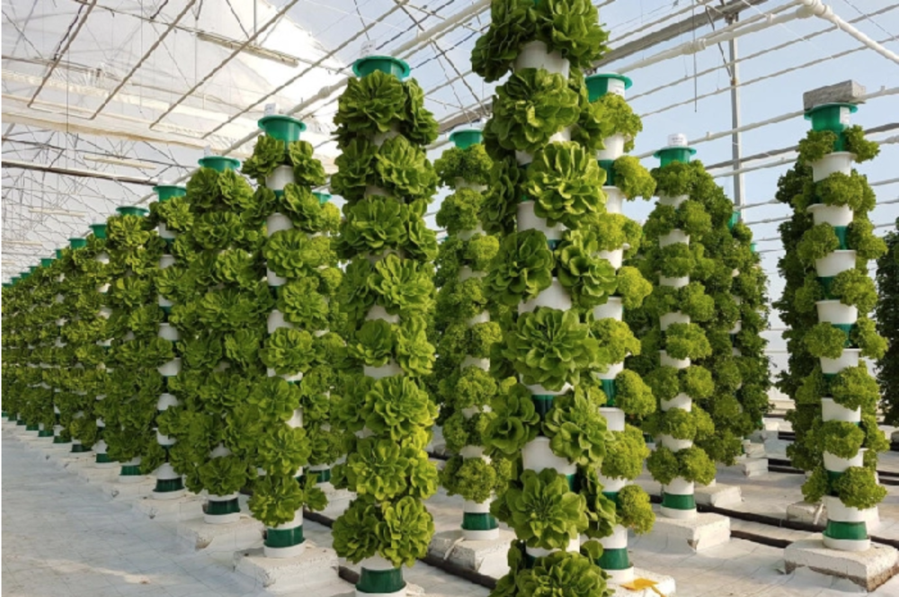
Introduction
Recent years trends and market conjunctions are increasingly provoking technological advancements in the agriculture industry. Growing population in urban areas and scarcity of free soil for crop farming together with the marginal cost advantage of robotics and automation which is now more affordable also for small enterprises, led to the development of new farming techniques such as vertical farming, rooftop farming and hydroponics
Background

Slide 3
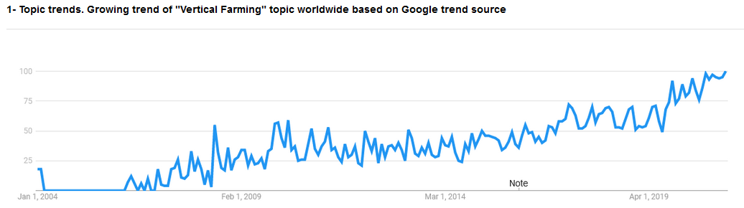
Quick facts: topic trend
Topics associated with Vertical farming have seen a relative general increase worldwide from 2006. The economic crisis of 2007-2009 and the consequent high unemployment fostered new experimental business models in traditional sectors like agriculture. The states which saw the biggest development are small, highly urbanized with small land areas for agriculture such as: Singapore, Denmark, Netherlands, Switzerland…

Slide 4
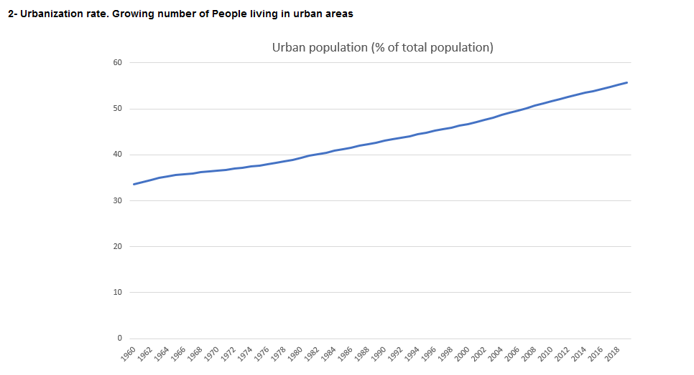
Quick facts: growing population
Given the upward urbanization rate worldwide, there will always be an increase demand for food coming from the major cities which could find alternative ways to supply fresh products and increase the standard.

Slide 5
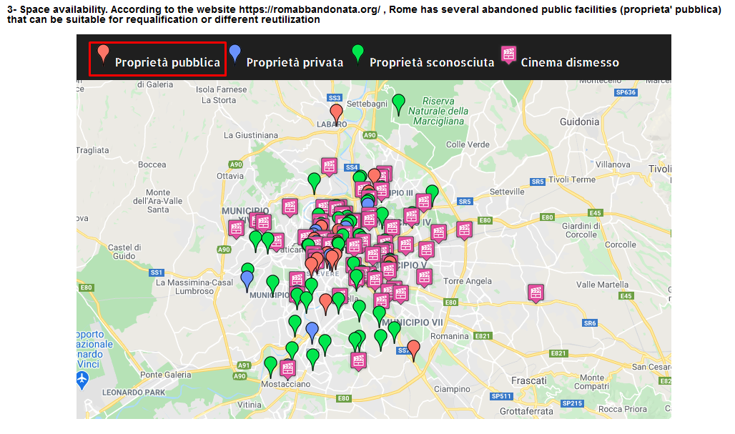
Quick facts: unutilized space
Several unutilized public areas in a city like Rome, could find alternative destination other than being left abandoned, fostering the culture of recycling, and urban requalification of damaged sites.

Slide 6
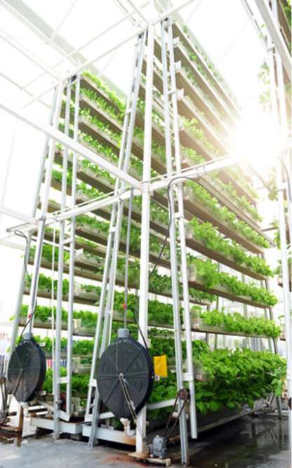



The Solution: Vertical Farm
Building sites recovery
Higher employment
Healthy Food
Abandoned building can be restored and applied for better usage
New-born businesses can absorb new workforce in places with high unemployment
Km 0 pest free organic vegetables

Slide 7
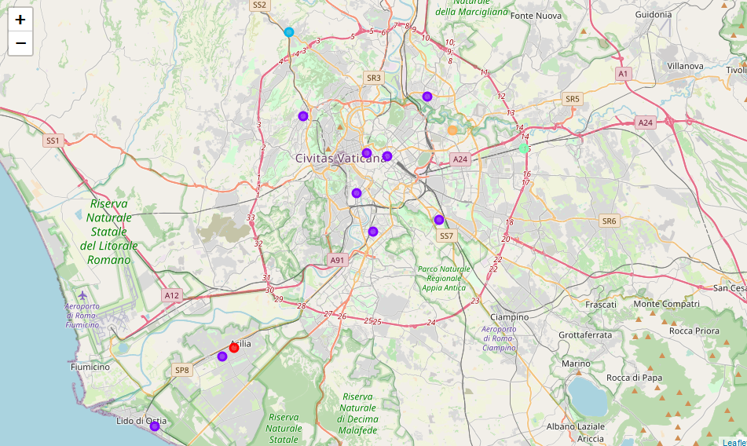
The locations in Rome
13 public areas were identified and clustered based on the venues categories
Rimessa Atac San Paolo
Ex Stazione Trastevere
Ufficio Geologico
Ex edificio scolastico I.T. Hertz
Ex edificio scolastico I.C La Giustiniana
Ex edificio scolastico Leonori
Edificio dismesso Verne
Edificio demolito Montebruno
Ex edificio scolastico Vertunni
Ex edificio scolastico Villari
Ex edificio scolastico Ripetta
Scuola Parini
Ex impianto Acea Oletta

Slide 8
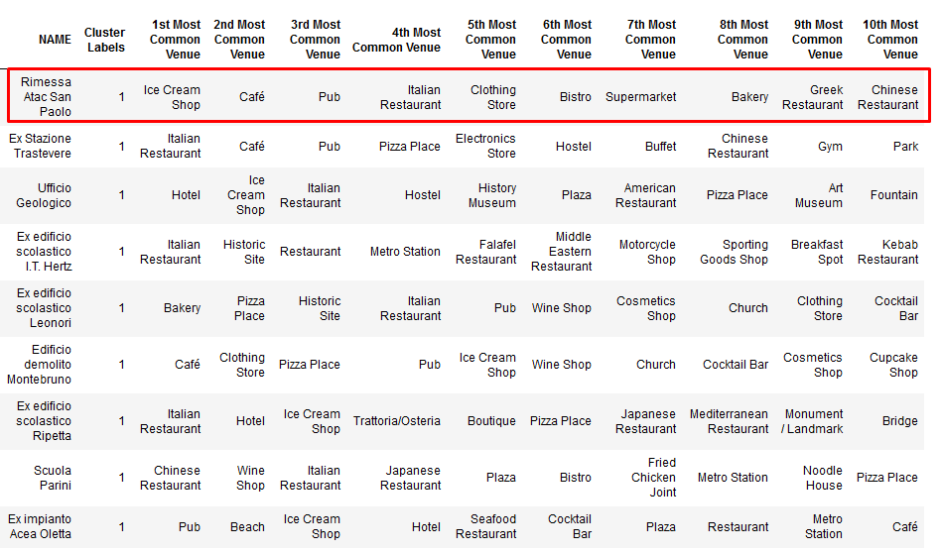
The venues
Clusters representatives of food businesses were ranked based on the most common venue frequencies in the top ten positions

Slide 9
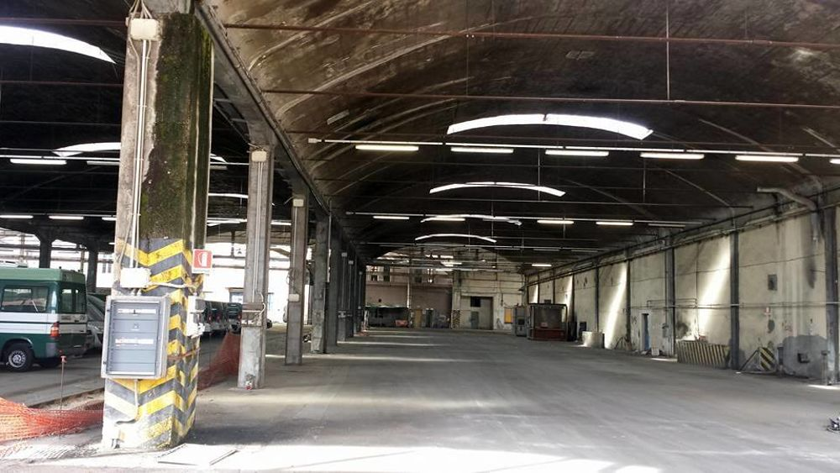
Conclusions
Rimessa Atac San Paolo proved to be the most suitable candidate to start a vertical farm in terms of number of collateral businesses in the food industry located in the surroundings of the site such as: Restaurants, Supermarkets, Pubs etc…

Slide 10
Thank you

